Slide 1
Immigration & Perceived Disorder: Fear of Crime or Xenophobia?
Douglas D. Perkins d.perkins@vanderbilt.edu,
Center for Community Studies http://peabody.vanderbilt.edu/ccs/
Vanderbilt University, Nashville, USA
Plenary Panel: 7° Convegno Nazionale:
La Prevenzione Nella Scuola E Nella Comunità:
“Convivenze, paure e reti informali”
Universita’ Degli Studi Di Padova
Dipartimento Di Psicologia
Dello Sviluppo E Della Socializzazione
Padova, 27 Giugno 2009

Slide 2
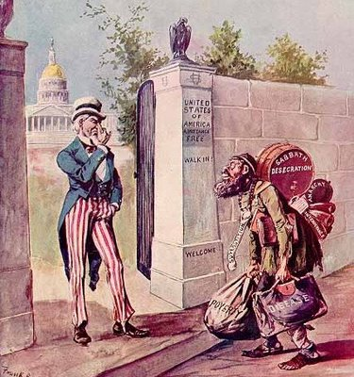
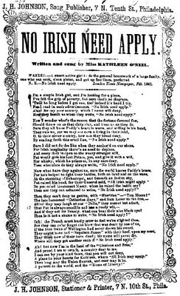
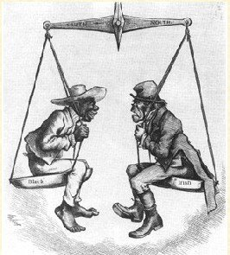
Anti-immigration attitudes in the U.S. are as old as the country itself
In mid-1800s, the “foreign devils” were the Irish, who were shown as filthy and equal to Blacks, i.e., the lowest.
Notes:
http://eristic-ragemail.blogspot.com/2008/06/oreilly-and-lou-dobbs-speaking-point.html

Slide 3
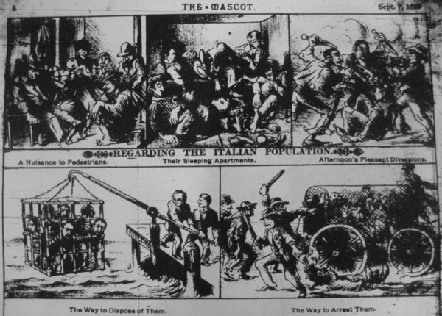
In the late 1800s, the immigrant menace were Italians!
Anti-Italian cartoon from The Mascot newspaper, 1888:
“If not totally black, Italians have certainly complicated the notion of whiteness in America so that they are neither totally white, and it is this in-between status that makes them likely candidates to support the abolition of whiteness as a privilege status in the U.S.A.”-Whites on a Leash: Italian Americans and White Privilege in the U.S. Fred Gardaphe (June 25, 2008)
Notes:
http://www.i-italy.org/bloggers/3011/whites-leash-italian-americans-and-white-privilege-u-s

Slide 4
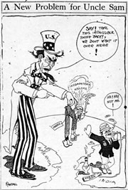
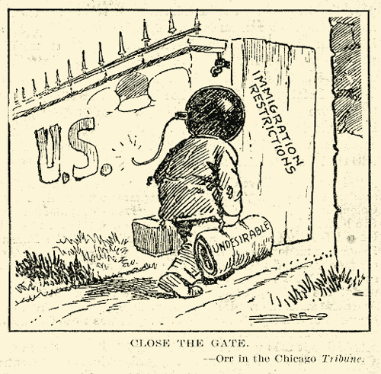
Anti-foreigner bias was especially strong in the early 1900s (newspaper cartoons from 1910 & 1919)
(Based on) “’mental tests’, 83% of Jews, 80% of Hungarians, 79% of Italians, & 87% of Poles & Russians are ‘feeble minded’.“ -Henry Goddard
Children of genetically "inferior races...should be segregated in special classes... They cannot master abstractions, but they can often be made efficient workers... There is no possibility at present of convincing society that they should not be allowed to reproduce, although from a eugenic point of view they constitute a grave problem because of their unusually prolific breeding” -Lewis Terman (1916)
Robert Yerkes & Carl Brigham used the results of the U.S. Army's WWI testing of recruits to argue that Blacks & Southern Europeans are intellectually inferior to those of Nordic descent.
Notes:
www.wingluke.org/.../mis-identity.html “Say! Take this impossible thing back! We don’t want it over here!-Mm, mm! Not me!”-This racist cartoon, published in the San Francisco Call on August 13, 1910, not only reflected anti-immigration sentiments rampant throughout the United States but also captured faulty stereotypes with the turbaned Sikh mis-labeled as “Hindu” and depicted smoking, almost unheard of within the Sikh community.
Photo credit: Bancroft Library, UC-Berkeley

Slide 5
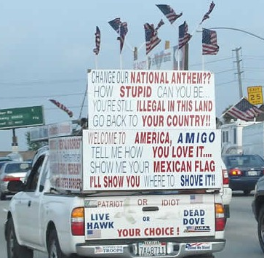
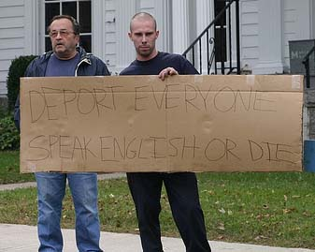
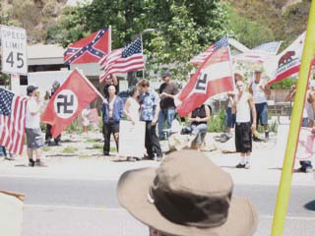
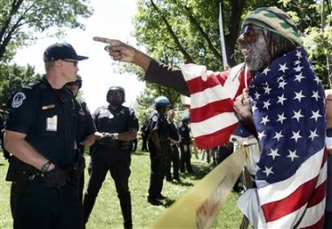
Current attitudes toward immigrants in the U.S.
Anti-immigration activists rally in California, Pennsylvania & Washington, DC
“Cambiare il nostro INNO NAZIONALE? Come si può essere cosi STUPIDI...
Tu sei ILLEGALE IN QUESTA TERRA. Torna al TUO PAESE! Benvenuti in America, AMICO. Dimmi come TI PIACE...
Mostrami la tua BANDIERA MESSICANA. Ti mostrerò dove LA DEVI FICCARE!! Patriota o idiota. Falco Vivo o Colomba morta. A te la scelta!”
Notes:
First 3 photos: http://www.appletreeblog.com/?cat=62 http://thetension.blogspot.com/2006_05_07_archive.html. 3rd:“Change our NATIONAL ANTHEM?? How STUPID can you be... You're still ILLEGAL IN THIS LAND. Go back to YOUR COUNTRY!! Welcome to AMERICA, AMIGO. Tell me how YOU LOVE IT... Show me your MEXICAN FLAG. I'LL SHOW YOU where to SHOVE IT!!
Patriot or idiot. Live Hawk or Dead Dove. Your choice!”

Slide 6
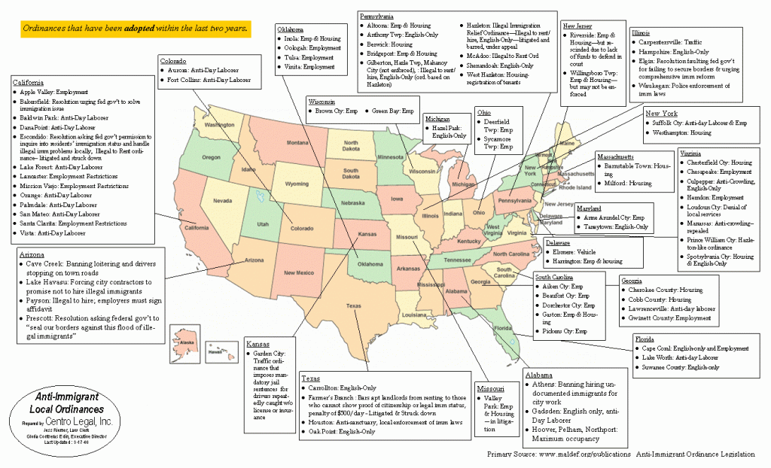
NOT just a radical extreme: Passed local anti-immigration ordinances in U.S.
Notes:
http://law.hamline.edu/library/faculty_archived_material.html

Slide 7
IN ITALIA TOO!
Notes:
“They have suffered immigration. Now living in the reservations! Think about it.” “Yes to polenta. No to cous cous. Proud of our traditions.”

Slide 8
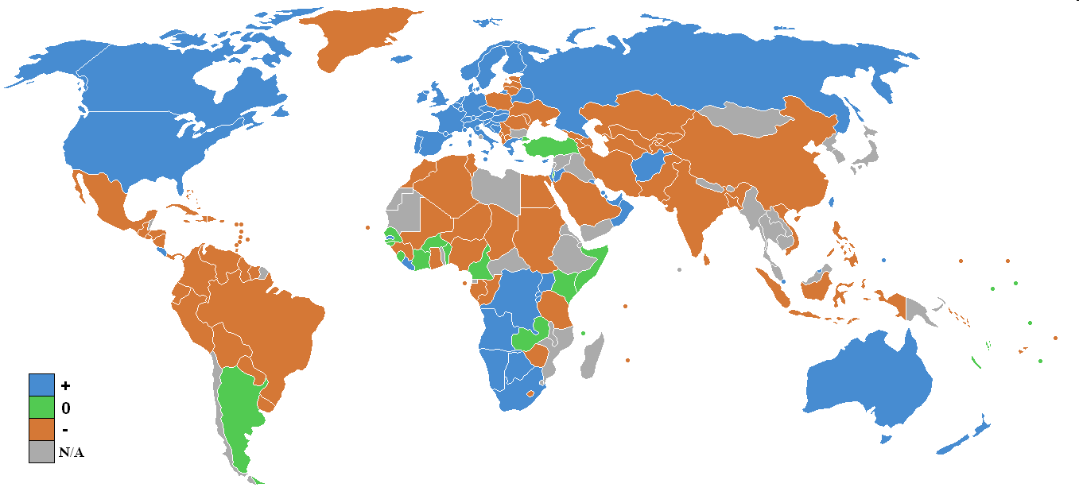
Net World Migration rate [2008 CIA Factbook update: positive (blue), negative (orange), stable (green), and no data (grey); https://www.cia.gov/library/publications/the-world-factbook]

Slide 9
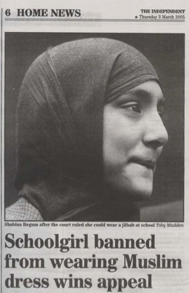
Problematic Responses: Forced Acculturation, Social Exclusion
Forced acculturation: language requirements, banning headscarves from public schools for “imperilling public order” (Adrian, 2006)
Social exclusion->immigrant ghettos (Geddes, 2000)-> crime & other social problems

Slide 10
Pager (2008): “The Republican ideal? National minorities and the criminal justice system in contemporary France.” Punishment & Society.
Growing concerns in France about perceived levels of social disorder and delinquency in immigrant neighborhoods
Variable geographic dispersion of immigrants
Compared punishment regimes across départements in France
Strong association between the presence of immigrants & increased police surveillance, broadening court jurisdiction, & harsher penalties
Immigrants=6% of population in France, 30% of prison population
How would Italy compare?
More research needed on social and political influences on the development and implementation of crime control and correctional strategies

Slide 11
Immigrants are more likely to be victims of crime than are native residents (Martens, 2000)
Immigrants who appear non-European are more often victims than are other immigrants. Those who are young, single, live in a large city, and reside in public housing are the most victimized and are most fearful
Immigrants have even more to fear since 11 September, 2001 (Collins, 2007; Naber, 2006)

Slide 12
Native Xenophobia and Perceptions of Disorder
Less about crime and more about feelings of insecurity due to perceived job displacement, territorial invasion, inadequate integration of newly arriving immigrants, interethnic confrontation, and a threat to native identity (Avramov & Cliquet, 2007; El Yamani, Juteau, & McAndrew, 1993)
News and popular media have exploited those fears (Casella & Massari, 2007; El Yamani et al, 1993)

Slide 13
Much recent research attention to immigrant acculturation & [individual] immigrant youth outcomes
USA: extensive research including July 2009 special issue of Journal of Primary Prevention on acculturation & immigrant adolescent health
Britain (Timotijevic & Breakwell, 2000)
Finland (Liebkind & Jasinskaja-Lahti, 2000)
Australia, Canada, Finland, France, Germany, Israel, Netherlands, New Zealand, Norway, Portugal, Sweden, UK, US (Berry, Phinney, Sam & Vedder, 2006)
Ireland & UK (Fong, 2008)
Germany & Israel (Slonim-Nevo, Mirsky, Rubinstein & Nauck, 2009)
Italia (1500 publications on immigration, racism & multiculturalism in Italy @ http://www.cirsdig.it/Pubblicazioni/Maritano.pdf.pdf ):
Torino (Carter, 1997; Ricucci, 2008)
Roma (Francescato)
Genova (Migliorini, Rania & Cardinali)
Padova & Aosta (Cristini, Scacchi & Santinello)

Slide 14
But until recently, too little focus on policy and other macro-societal influences, political acculturation, & host community responses to immigrants and immigration
Recent Exceptions:
Dec. 2008 Special Section of AJCP on ‘‘The Other Side of Acculturation: Changes among Host Individuals and Communities in Their Adaptation to Immigrant Populations’’
Reconceptualizes acculturation by focusing more on ecological processes, historical contexts, and power inequities
Italy:
Grillo, R. D., & Pratt, J. C. (Eds.). (2002). The politics of recognizing difference: Multiculturalism Italian-style. Ashgate. [incl. “An obsession with cultural difference: representations of immigrants in Turin” by Maritano]
Prezza et al (2008). Territorial Sense of Community, Ethnic Prejudice and Political Orientation. JCASP.
Community practice in Italy: Martini Associati projects.
Germany: Simon & Ruhs (2008). Identity and politicization among Turkish migrants in Germany: The role of dual identification. Journal of Personality and Social Psychology.
Spain, Belgium & Italy: García-Ramírez, Paloma, Suarez-Balcazar & Balcazar (in press). Building International Collaborative Capacity: Contributions of Community Psychologists to a European Network. AJCP.

Slide 15
Comprehensive Ecological Model for Analyzing power Dynamics across 4 Domains of Capital & 3 Levels
Consequence or stage of empowerment/wellness: Oppression Liberation/Empowerment Wellness
(state) (process) (outcome)
Domain of Political: [POLITICAL CAPITAL]
Environment/Capital:
Economic: [FINANCIAL CAPITAL]
Physical: [PHYSICAL CAPITAL]
Level of Analysis/
Intervention: Socio-cultural: [SOCIAL CAPITAL]
Macro/ Collective/ Structural/ Community
political & economic structures in society that threaten social wellness; both oppressed populations & reactive actions of policy makers & stakeholders.
collective social action, community organizing & networks; movements, techniques, community processes & societal policies that lead to attainment of popular goals
macro-level social variables that affect human wellness. Scrutinizes social policies for optimal promotion of community wellness
Meso/
Organizational Group/
Relational
organizations that violate standards of social justice for workers & communities; group inequities in social wellness
both change in organizations creating social problems & org. learning, decision-making, & development in groups & institutions addressing social oppression & justice
identifies/promotes participatory organizational opportunities & methods of reducing social threats & enhancing social wellness
Micro/Individual/ Personal/
Psychological (emotional, cognitive, behavioral, spiritual):
relationship between setting-level social conditions & individual powerlessness, helplessness, internalized oppression, guilt, & physical & mental problems
individual human capital (skills, knowledge), behaviors, & beliefs that affect immediate conditions; social & political consciousness, activism, leadership, & self-efficacy
relationship between social variables & personal wellness; dynamics promoting self-determination, pride, empowerment, health, personal growth, meaning & spirituality

Slide 16
Comprehensive Model for Action Research on Immigrant Communities: Socio-cultural Context
Consequence or stage of empowerment/wellness: Oppression Liberation/Empowerment Wellness
(state) (process) (outcome)
Domain of Political:
Environment/Capital:
Economic:
Physical:
Level of Analysis/
Intervention: Socio-cultural:
Macro/ Collective/ Structural/ Community
oppressive influences of both original and host cultures; help solve social problems in countries of origin that contribute to immigration
societal processes, structures & policies promoting organizing & participation by migrants & acceptance & inclusion by host communities
policies & other macro variables affecting migrant community wellness (eg, places & accomodations for religious & other cultural practices)
Meso/
Organizational Group/
Relational
organizations that violate standards of social justice for immigrant workers & communities; setting-level influences on family & individual powerlessness
change in organizations affecting immigrants; migrant worker & client participation in org. decisions, esp. those affecting immigrants
Identify & promote organized opportunities & methods of reducing social threats to, & enhancing social wellness of, migrants
Micro/IndividualPersonal/
Psychological (emotional, cognitive, behavioral, spiritual):
oppressive migrant family cultural practices & micro-social dynamics, helplessness, stigma
human capital (skills, knowledge), behaviors, beliefs affecting immigrants; migrant social/political consciousness, activism, leadership, & self-efficacy
Strengths & social supports of immigrant families & cultures promoting personal wellness

Slide 17
Youth Violence
Prevention Collaboration
Schools Churches Human Service
Neighborhood Organizations Governmental Orgs Youth
Immigrant Organizations Health & Mental Health

Slide 18
Comprehensive Model for Action Research on Immigrant Communities: Physical Environment Context
Consequence or stage of empowerment/wellness: Oppression Liberation/Empowerment Wellness
(state) (process) (outcome)
Domain of Political:
Environment/Capital:
Economic:
Sociocultural:
Level of Analysis/
Intervention: Physical:
Macro/ Collective/ Structural/ Community
Document environmental policies that discriminiate against immigrant communities and their impact; Help solve env. problems in countries of origin that contribute to immigration
Community organizing & network theories; compares movements, strategies; seeks to understand & enhance structures that lead to environmental justice for immigrants
Design policies to promote healthy physical conditions in workplace & ethnic neighborhoods [e.g, placement of industrial & contaminated sites]
Meso/
Organizational Group/
Relational
Examines organizations that violate standards of environmental justice for migrant workers & communities
Identify/promote participatory opportunities for immigrants in groups & institutions addressing env. risks
methods of reducing environmental threats & enhancing environmental wellness in minority communities
Micro/IndividualPersonal/
Psychological (emotional, cognitive, behavioral, spiritual):
Study setting-level env. features/conditions & their effects on individual powerlessness, helplessness, internalized oppression among migrants
Behaviors & beliefs affecting individuals’ immediate environment; immigrants’ environmental consciousness, activism, leadership, & self-efficacy
Relationship between env. variables & personal wellness; Identifies culturally sensitive dynamics promoting self-determination, health, personal growth, meaning

Slide 19
Comprehensive Model for Action Research on Immigrant Communities: Economic Context
Consequence or stage of empowerment/wellness: Oppression Liberation/Empowerment Wellness
(state) (process) (outcome)
Domain of Political:
Environment/Capital:
Socio-cultural:
Physical:
Level of Analysis/
Intervention: Economic:
Macro/ Collective/ Structural/ Community
Study oppressive influences of globalization, national & corporate economic interests on migrant & domestic labor
Unions, structures & policies promoting migrant worker organization & participation
Government & corporate policies affecting migrant financial wellness (eg, open employment, livable wages)
Meso/
Organizational Group/
Relational
Identify organizations that exploit or violate standards of economic justice for immigrant workers
Facilitate immigrant membership in union locals & other opportunities for organizational participation
Identify & promote organized opportunities & methods of reducing economic threats to, & enhancing economic wellness of, migrants
Micro/Individual/ Personal/
Psychological (emotional, cognitive, behavioral, spiritual):
Study micro-economics of oppressive labor conditions & how it affects immigrant families
Immigrant education & training for human capital development & better economic opportunities; leadership development in unions & companies
Document wellness benefits of livable employment on immigrants & families

Slide 20
Comprehensive Model for Action Research on Immigrant Communities: Political Context
Consequence or stage of empowerment/wellness: Oppression Liberation/Empowerment Wellness
(state) (process) (outcome)
Domain of Socio-cultural:
Environment/Capital:
Economic:
Physical:
Level of Analysis/
Intervention: Political:
Macro/ Collective/ Structural/ Community
Oppressive political structures in both origin & host societies (eg, profiling & other discriminatory employment, housing & education policies)
Empowering structures & policies promoting participation by migrants & acceptance & inclusion by host communities
Policies & political structures affecting migrant community wellness
Meso/
Organizational Group/
Relational
Identify organizations that discriminate against or otherwise oppress immigrants; setting-level influences on powerlessness
Structural change in organizations to increase immigrant participation in decisions, esp. those affecting immigrants
Assist advocacy & other organizations promoting political rights and wellness of immigrants
Micro/Individual/ Personal/
Psychological (emotional, cognitive, behavioral, spiritual):
Oppressive migrant family structures & dynamics, internalized oppression, political apathy
Develop immigrant political consciousness, skills, knowledge, activism, leadership; Public education to change anti-immigrant beliefs & behaviors
Enhance participation, political wellness, self-efficacy of immigrants [which improves democracy for all]

Slide 21
Grazie!
References
Adrian, M. (2006). Laicite Unveiled: A Case Study in Human Rights, Religion, and Culture in France. Human Rights Review, 8(1), 102-114.
Avramov, D., & Cliquet, R. (2007). Xenophobia and Integration of Immigrants. Attitudes of Europeans towards Foreigners. Zeitschrift fur Bevolkerungswissenschaft, 32(3-4), 533-560.
Berry, J. W., Phinney, J. S., Sam, D. L., & Vedder, P. (2006). Immigrant Youth: Acculturation, Identity, and Adaptation. Applied Psychology: An International Review, 55(3), 303-332.
Carter, D. M. (1997). States of Grace: Senegalese in Italy and the New European Immigration. Univ. of Minnesota Press.
Casella, A., & Massari, L. (2007). The 2006 Pardon: A Sensible Hope for a Judicious Clemency. Aggiornamenti Sociali, 58(3), 175-186.
Christens, B., & Perkins, D. D. (2008). Transdisciplinary, multilevel action research to enhance ecological and psycho-political validity. Journal of Community Psychology, 36(2), 214-231.
Collins, J. (2007). Immigrants as victims of crime and criminal justice discourse in Australia. International Review of Victimology, 14(1), 57-79.
El Yamani, M., Juteau, D., & McAndrew, M. (1993). Immigration: What Do Quebecers Fear? Revue internationale d'action communautaire/International Review of Community Development(autumn), 61-70.
Fong, V. L. (2008). The other side of the healthy immigrant paradox: Chinese sojourners in Ireland and Britain who return to China due to personal and familial health crises. Culture, Medicine and Psychiatry, 32(4), 627-641.
García-Ramírez, M., Paloma, Suarez-Balcazar, Y., & Balcazar, F. (in press). Building International Collaborative Capacity: Contributions of Community Psychologists to a European Network. American J. of Community Psychology.
Geddes, M. (2000). Tackling Social Exclusion in the European Union? The Limits to the New Orthodoxy of Local Partnership. International Journal of Urban and Regional Research, 24(4), 782-800.
Goodkind, J. R., & Foster-Fishman, P. G. (2002). Integrating diversity and fostering interdependence: Ecological lessons learned about refugee participation in multiethnic communities. Journal of Community Psychology, 30(4), 389-410.
Grillo, R. D., & Pratt, J. C. (Eds.). (2002). The politics of recognizing difference: Multiculturalism Italian-style. Ashgate.
Liebkind, K., & Jasinskaja-Lahti, I. (2000). The influence of experiences of discrimination on psychological stress: A comparison of seven immigrant groups. Journal of Community & Applied Social Psychology, 10(1), 1-16.
Martens, P. L. (2000). Immigrants as victims of crime. International Review of Victimology, 8(2), 199-216.
Mazumdar, S., Mazumdar, S., Docuyanan, F., & McLaughlin, C. M. (2000). Creating a sense of place: The Vietnamese-Americans and Little Saigon. Journal of Environmental Psychology, 20(4), 319-333.
Naber, N. (2006). The Rules of Forced Engagement: Race, Gender, and the Culture of Fear among Arab Immigrants in San Francisco Post-9/11. Cultural Dynamics, 18(3), 235-267.
Pager, D. (2008). The Republican ideal?: National minorities and the criminal justice system in contemporary France. Punishment & Society, 10(4), 375-400.
Prezza, M., Zampatti, E., Pacilli, M. G., & Paoliello, A. (2008). Territorial sense of community, ethnic prejudice and political orientation. Journal of Community & Applied Social Psychology, 18(4), 315-332.
Ricucci, R. (2008). Educating immigrant children in a 'newcomer' immigration country. A case study. Intercultural Education, 19(5), 449-460.
Simon, B., & Ruhs, D. (2008). Identity and politicization among Turkish migrants in Germany: The role of dual identification. Journal of Personality and Social Psychology, 95(6), 1354-1366.
Slonim-Nevo, V., Mirsky, J., Rubinstein, L., & Nauck, B. (2009). The impact of familial and environmental factors on the adjustment of immigrants: A longitudinal study. Journal of Family Issues, 30, 92-123.
Timotijevic, L., & Breakwell, G. M. (2000). Migration and threat to identity. Journal of Community and Applied Social Psychology, 10(5), 355-372.

