Slide 1



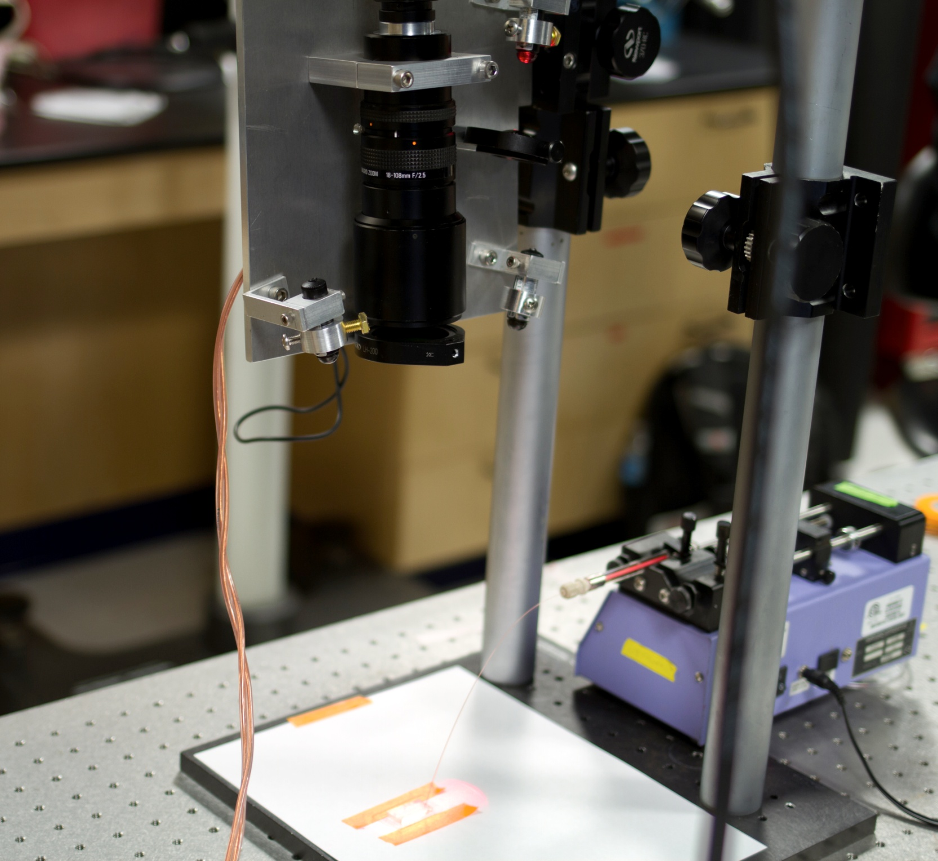
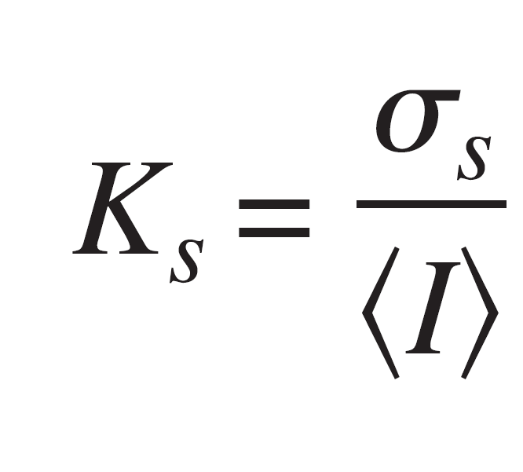
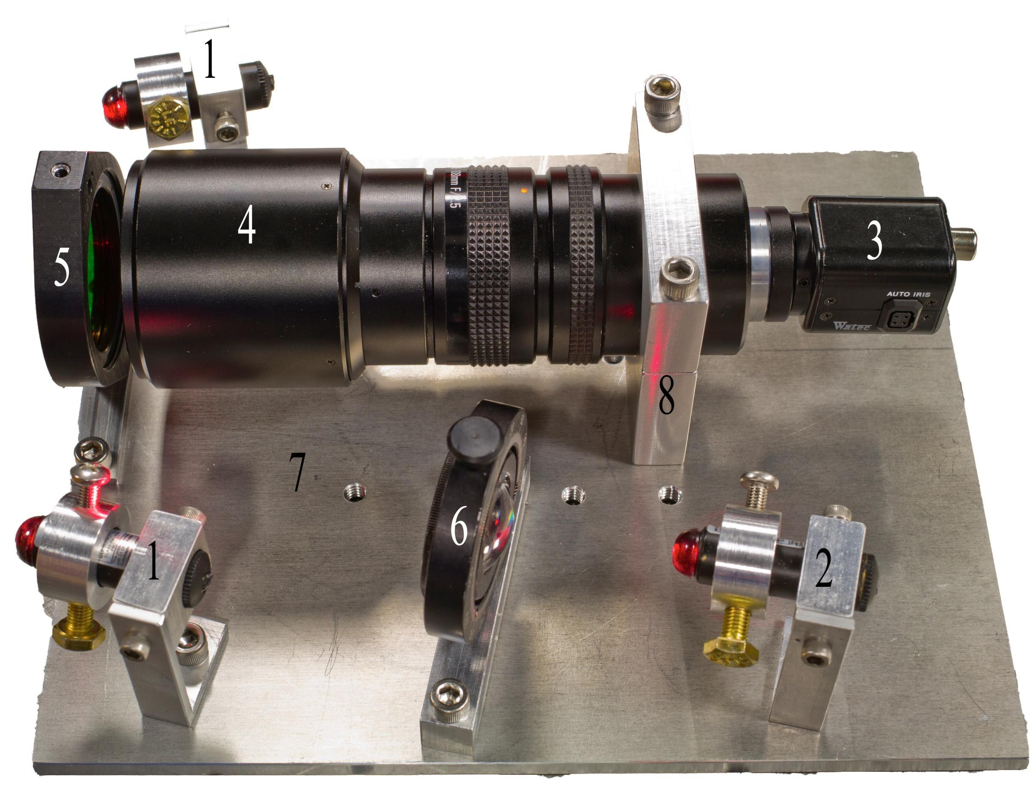
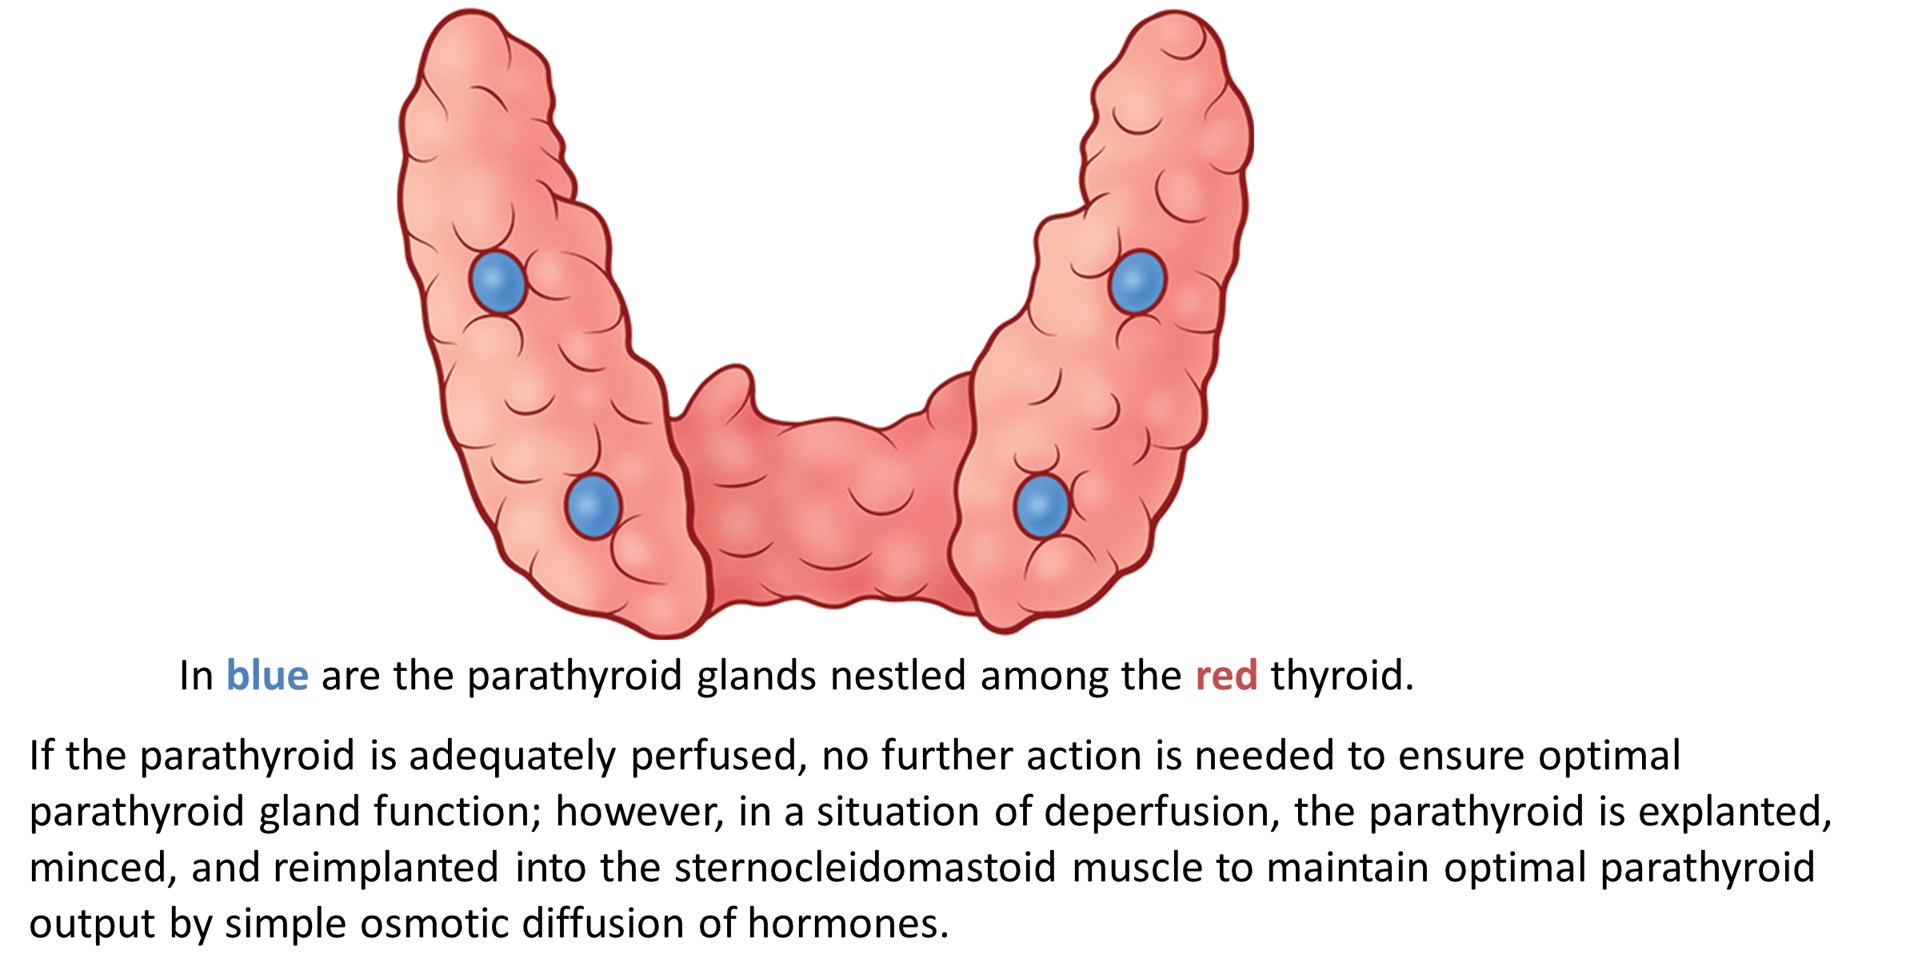
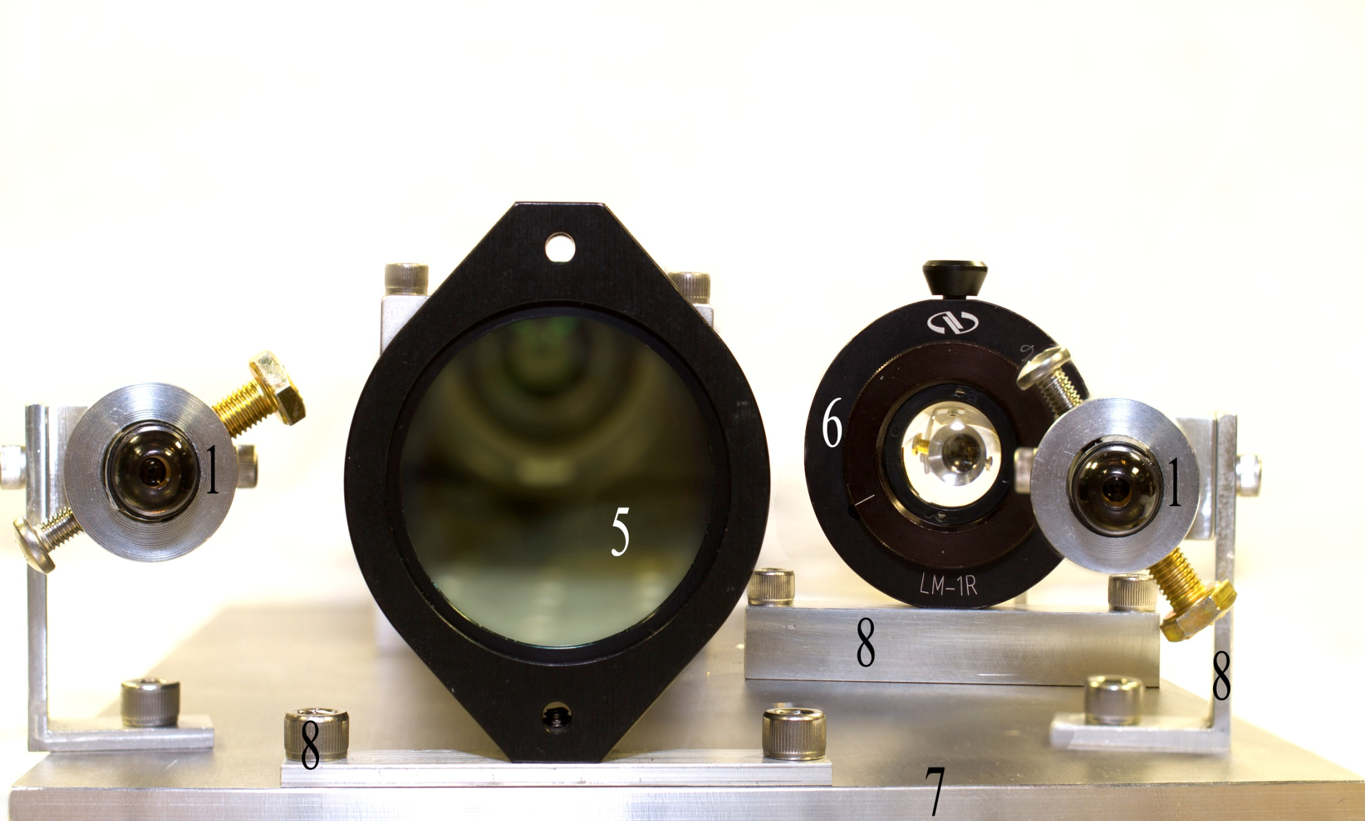
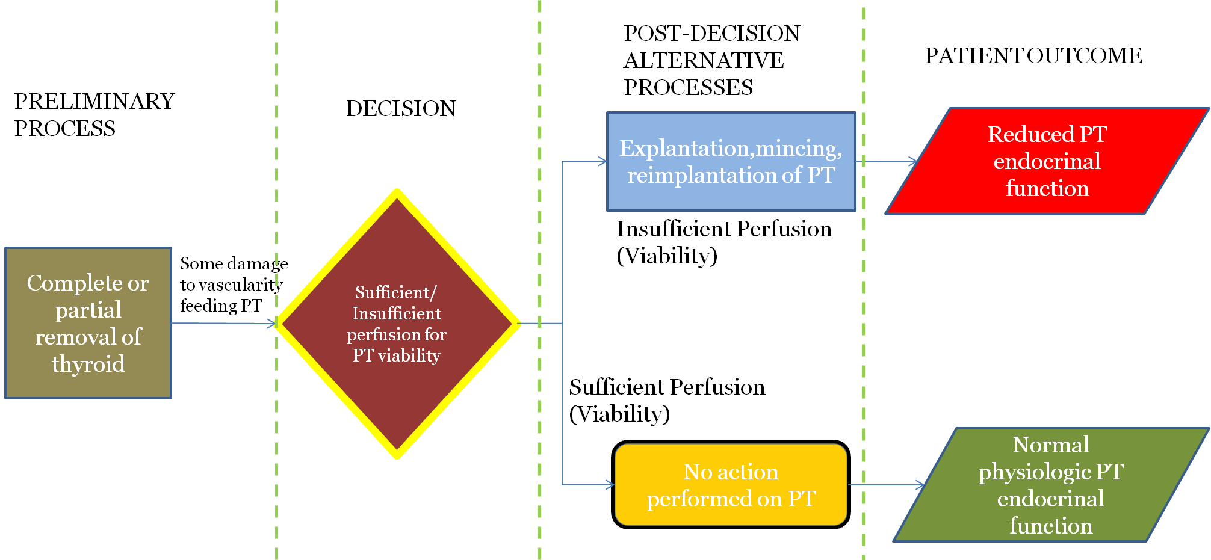
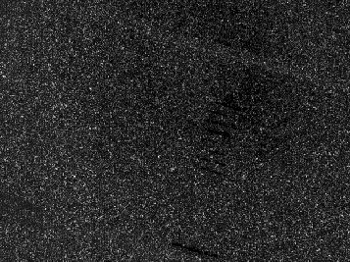
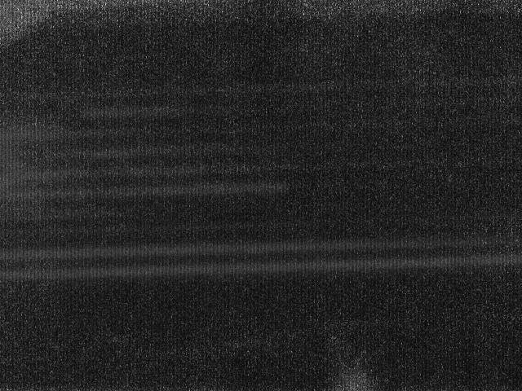
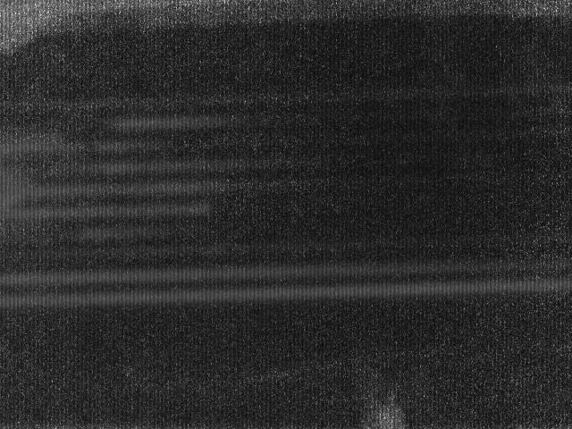
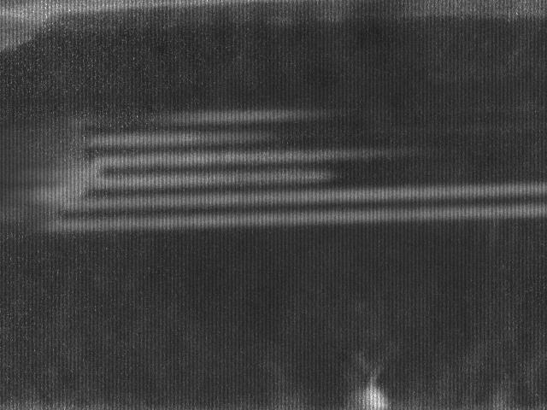
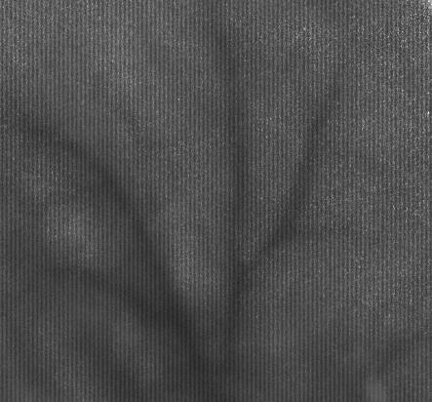
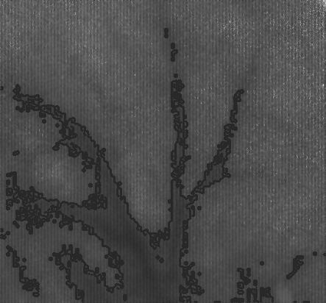
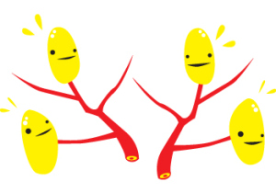
Laser Speckle Contrast System for Determination of Parathyroid Perfusion
Gabriela Caires de Jesus, Tianhang Lu, Itamar Shapira, James Tatum, Yu Zhou
Advisors: Anita Mahadevan-Jansen, Ph.D. , Matthew Walker III, Ph.D.
PROBLEM STATEMENT
Design Theory/Components
Future Considerations
Surgical operations to remove the thyroid gland may inadvertently result in a loss of perfusion (blood flow) to the surrounding parathyroid glands. Other than visual observation, endocrine surgeons have no way of knowing the perfusion state of the parathyroid glands.
Laser Speckle Theory
DEVICE IMPROVEMENTS
Background
Diffuse Reflectance
Speckle Pattern
Contrast Equation
Reduce size/ weight of overall device
Cut out parts of base not supporting the components
Use a smaller and more compact macro lens
  The current macro lens is the largest and the most expensive part of our design
BACKGROUND
The thyroid gland, an important part of the endocrine system, sometimes displays hypertrophy, becomes cancerous, or experiences other pathophysiological conditions. The parathyroid glands, four of which are situated posterior to the thyroid, are critical to endocrine system regulation of calcium homeostasis.
In an operation to remove the thyroid, surgeons may inadvertently lacerate or otherwise damage vascular beds feeding the parathyroid; consequently parathyroid glands lose perfusion and will eventually necrose. Surgeons currently inspect the parathyroid glands visually to best determine the perfusion state; however, many surgeons do not have the high patient volumes necessary to develop a strong perfusion intuition.
Quantifying flow relationship
Current progress has shown that in no flow conditions of the phantom, device does not register perfusion. The processed image shows a stronger contrast between areas of flow and no flow. We are currently investigating this relationship to set a standard for flow detection. Some additional investigation needs to be conducted regarding the device’s variability, detection range and sensitivity.
Preparations for clinical testing
In order to improve the ease of our device, several developments could be made:
Improve compatibility with current parathyroid detection device
Better integrate device with surgical equipment: surgical arm or IV pole
Develop components that allows for easier sterilization
Streamline data acquisition process
Design Components
2 Guide Laser Pointers
1 Source Laser Pointer
CCD Camera
Macro zoom lens
650 nm Filter
Source -laser Beam Expansion Lens
Base plate
Component mounting
hormone.org
Conclusion
We have:
Identified Laser Speckle as an imaging technique that will detect perfusion,
Designed and created a device that meets the needs
Validated our device through both animal and phantom testing. Future work needs to be done to improve the device for a clinical setting.
We would like to thank our advisors Dr. Anita Mahadevan-Jansen and Dr. Matthew Walker III for their insight and guidance throughout this process, Dr. James Broome for his expertise on the clinical considerations, Melanie McWade for her weekly help and meetings, John Fellenstein for his tireless and high quality machining, Kristin Poole for her help with animal testing, and Isaac Pence and the other graduate students at the BME Biophotonics Lab for their help.
1. Briers, David J.. "Laser speckle contrast imaging for measuring blood flow ." Optica Applicata 37 (2007): 139-152. Print.
2. Richards, Lisa M., S. M. Shams Kazmi, Janel L. Davis, Katherine E. Olin, and Andrew K. Dunn. "Low-cost laser speckle contrast imaging of blood flow using a webcam." Biomedical Optics Express 4.10 (2013): 2269. Print.
3. Tom, W.j., A. Ponticorvo, and A.k. Dunn. "Efficient Processing of Laser Speckle Contrast Images." IEEE Transactions on Medical Imaging 27.12 (2008): 1728-1738. Print.
Validation
Using a PDMS microfluidics phantom pumped with a solution of polystyrene beads, we were able to validate that our device is able to detect the presence of flow.
Capture 150 images through LabView at 29.7 fps
Use temporal image processing in MatLab
No Flow
.01 μL/minute
.10 μL/minute
1.0 μL/minute
Acknowledgements
Needs
Must have clinical utility.
Device should use maximally low cost components.
Speckle Ratio: a means to give a quantitative value to our images
  Speckle ratio = mean intensity vessel/mean intensity background
Early tests indicate a positive correlation, although more tests are needed
Animal Model
Device must determine perfusion state.
References
Iheartguts.wordpress.com
 | Test 5 | Test 6 | Test 7 | Test 8 | Test 9
Ratio | 0.7205 | 0.7164 | 0.7132 | 0.7277 | 0.7161

